Slide 1
IoC Skills Bootcamp Data Science and Cloud Systems
Project#5
Driver Drowsiness Detection System Using Python with OpenCV, Keras, TensorFlow & Pygame
Team Members:
Sharath Prakash Mohammed Sardar Sarah Colville-Los

Slide 2
Table of Content
Introduction
Motivation
Implementation
Results

Slide 3
Introduction
Driver’s drowsiness is a major cause of road accidents, and an early alert or warning could avert a disastrous situation and hence saving precious life(s).
We have extensively use Python Programming along with:
OpenCV → Library of programming functions aimed at real-time computer vision
Face and Eye Detection
TensorFlow → SW library for ML and AI. Focus on training & interference of deep neural networks
Backend for Keras
Keras → Python interface for artificial neural networks. Interface for TensorFlow library
Classification Model
Pygame → Library for Computer Graphics and sound library
Sound Alarm

Slide 4
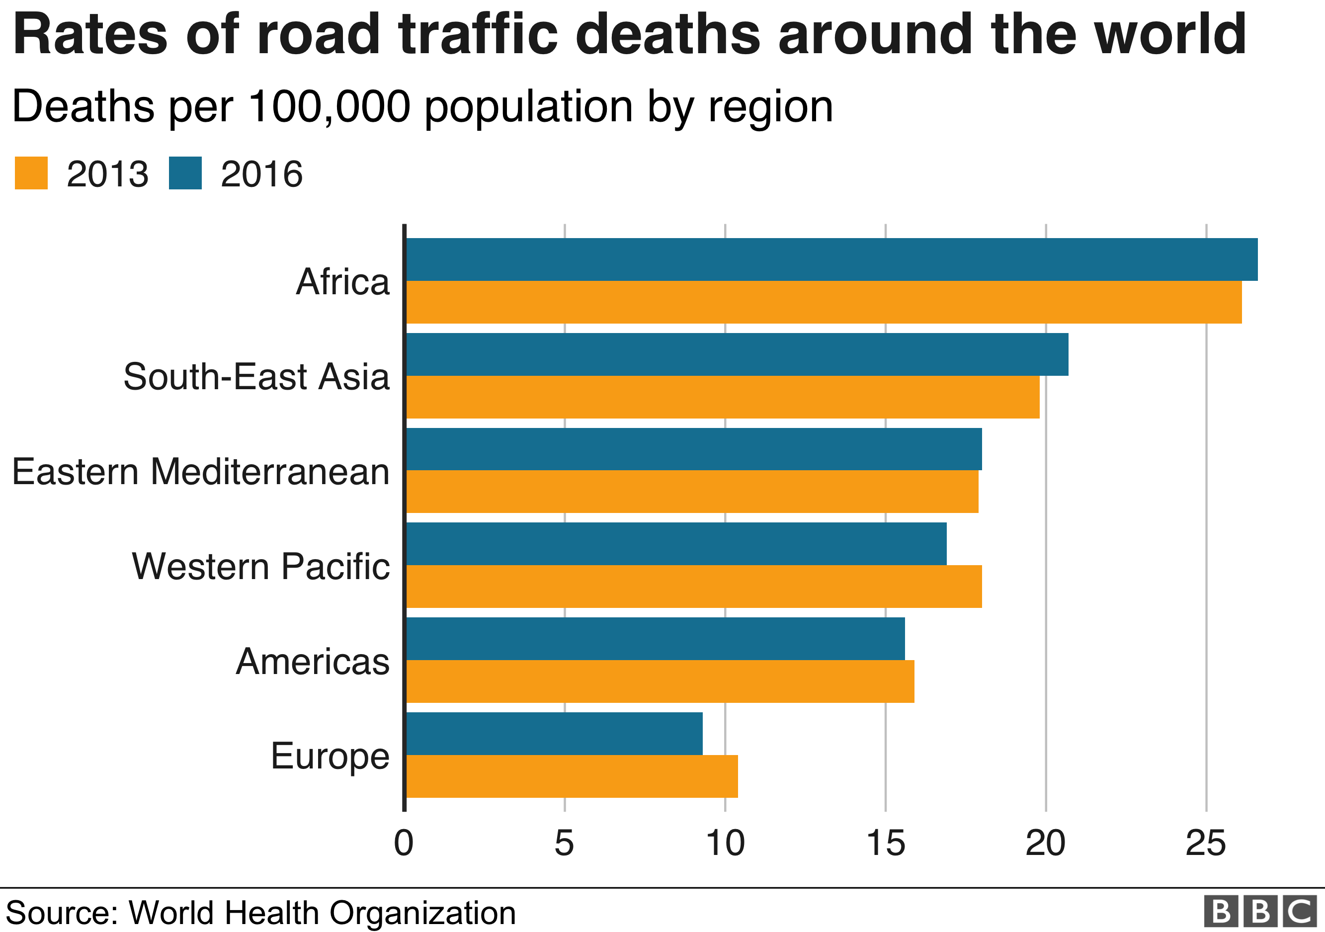
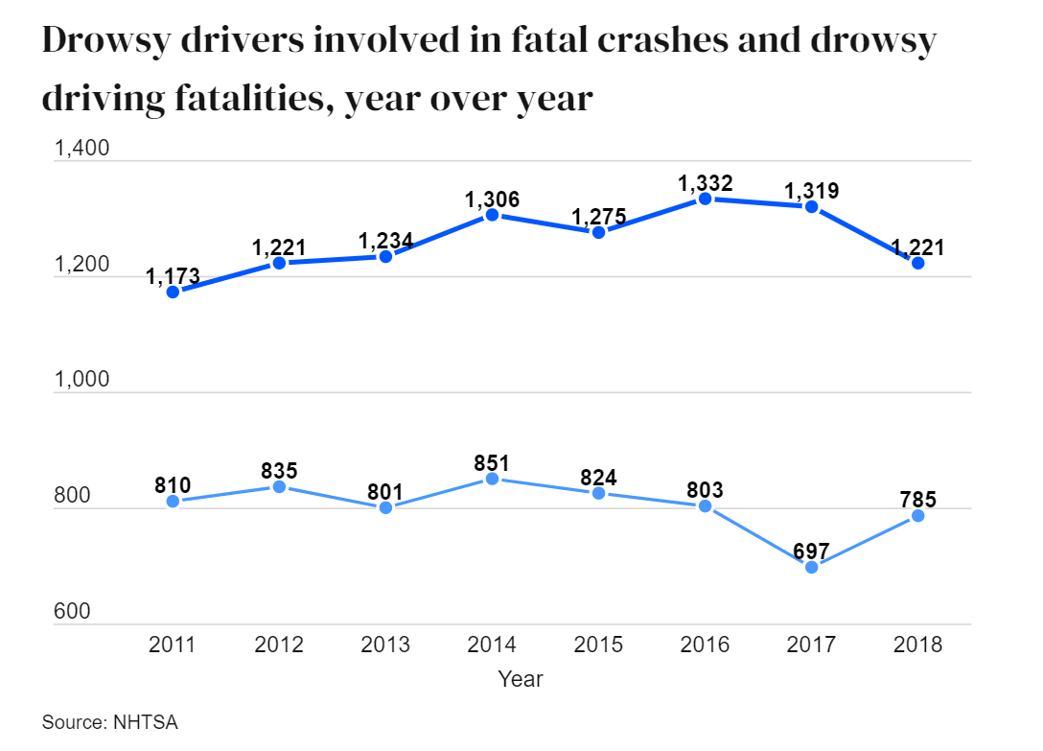
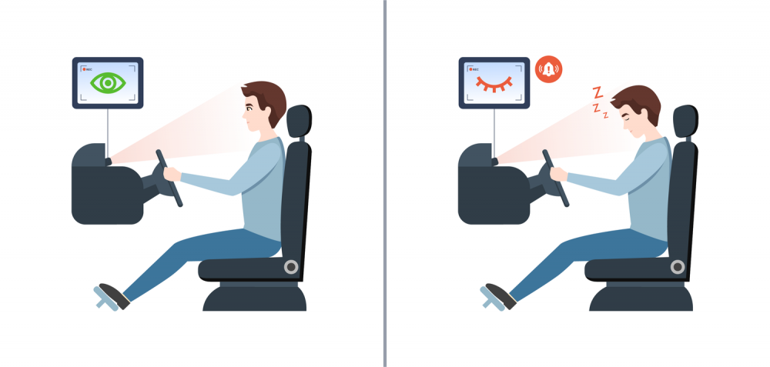
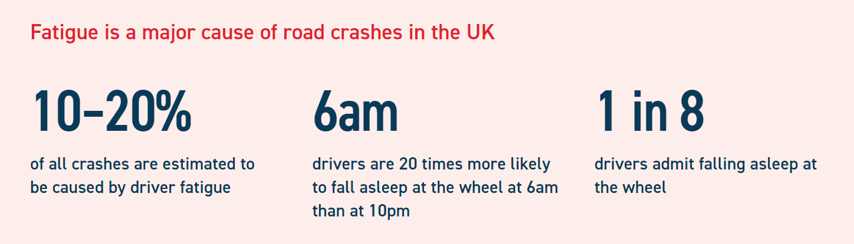
Motivation
Research suggests that almost 20 per cent of accidents on major roads are sleep-related and occur because the driver is drowsy. Such accidents are also more likely to result in a fatality or serious injury.
Our solution to this predicament:
Driver Drowsiness Detection System

Slide 5

Implementation
Technique: Convolutional Neural Network (CNN)
CNN is a Deep Learning Algorithm.
-Take an input image,
- Assign importance to various aspects/objects in the image
- Ability to differentiate one from other.
- Pre-processing is much lower compare to other classification algorithms.
- Ability to learn filters/characteristics

Slide 6
Implementation
Algorithms
Image input from Camera
Face Detection
Region of Interest
Eyes Detection
Classifier
Eyes Open
Eyes Closed
Drowsiness Detection
Score
Buzzer

Slide 7

Results
The driver drowsiness detection system detects drowsiness quickly.
The System would score, if the eyes were closed for a prolonged time duration
The system differentiates between a normal eye blink to that of a drowsy eye and can prevent the driver from entering a state of sleepiness, by sounding an alarm to alert the driver before an accident occurs.
Detects Male/Female faces, people with spectacles

Slide 8
Future Work
Detect Facial expression to trace the Driver’s emotions and detect the mood:
- If happy, Greet him/her, or call friends/family for a party/catchup meeting
- If Sad, dial-in or contact Family/Friends
- If in tear/pain, dial emergency services

